Slide 1
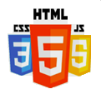

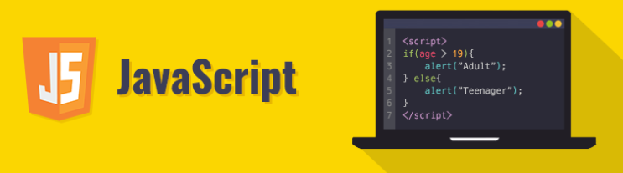
Ambo University| Woliso Campus
School of Technology and Informatics
Department of Information Technology
Internet Programming I (ITec2092)
Jerusalem F., MSc
jerusalem.sweng@gmail.com
Chapter Four:
JavaScript

Slide 2

Contents
Introduction
Language Format 3
Data types and primitives Functions in JavaScript
Assigns function to event
Sessions and cookies using JavaScript

Slide 3
Introduction to JavaScript
JavaScript (JS) is a lightweight, interpreted, or just-in-time compiled programming language.
It is known as the scripting language for Web pages.
JS allows you to implement complex features on web pages (interactive maps, animated graphics, etc.).
It is the third layer of the standard web technologies (HTML for structure, CSS for style).
JavaScript is cross-platform and open-source.

Slide 4
History and Evolution
Created by Brendan Eich at Netscape in 1995.
Originally called Mocha, then LiveScript, and finally JavaScript.
Standardized by ECMA International (ECMAScript).
Modern JS (ES6+) has transformed it into a powerful full-stack language.
Used today for front-end, back-end (Node.js), and mobile app development.
Note: ECMA (European Computer Manufacturers Association)

Slide 5
Client-Side vs. Server-Side
JavaScript is primarily a client-side language, meaning it runs in the user's browser.
The browser downloads the JS code and executes it locally.
This reduces the load on the server and provides faster feedback to the user.
Server-side JS (like Node.js) handles database connections and file systems.
In this chapter, we focus on client-side JS for browser interactivity.

Slide 6

Language Format: Integration in HTML
JS is added to HTML using the <script> tag.
Internal JS: Placing code between <script> and </script> in the head or body.
External JS: Using the src attribute: <script src="script.js"></script>.
Inline JS: Using HTML attributes like onclick="alert('Hello!’)”.
Best Practice: Use external files to keep HTML clean and improve caching.

Slide 7
Basic Syntax and Rules
JavaScript is case-sensitive (myVar is different from myvar).
Statements should end with a semicolon ; (though optional, it is highly recommended).
Comments: Single-line // or multi-line /* ... */.
Identifiers must start with a letter, underscore _, or dollar sign $.
White space is ignored except inside strings.

Slide 8
JavaScript Data Types (Primitives)
Number: Represents both integer and floating-point numbers (e.g., 10, 3.14).
String: Textual data enclosed in quotes ("Hello" or 'Hi').
Boolean: Logical values true or false.
Undefined: A variable that has been declared but not assigned a value.
Null: Represents an intentional absence of any object value.
Object: is the building blocks for modern JavaScript
Primitive data types
Special data types
Composite data type
Note: Array and function are also composite data types.

Slide 9
Variable Declaration (var, let, const)
var: The old way; function-scoped and can be redeclared.
let: Block-scoped; cannot be redeclared in the same scope (modern standard).
const: For constants; values that cannot be reassigned.
Example: let studentName = “Akawaaq";
Example: const gravity = 9.81;

Slide 10
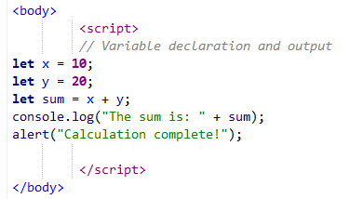

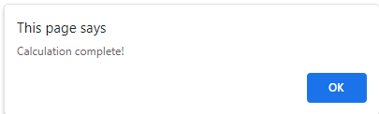
Worked Example 1: Basic Variables
console.log() is used for debugging in the browser console.
alert() creates a pop-up box.

Slide 11
JavaScript Operators
Arithmetic: +, -, *, /, % (modulus), ++ (increment), -- (decrement).
Assignment: =, +=, -=, *=.
Comparison: == (equal to), === (equal value and type), !=, >, <.
Logical: && (AND), || (OR), ! (NOT).
String concatenation: Using + to join strings.

Slide 12
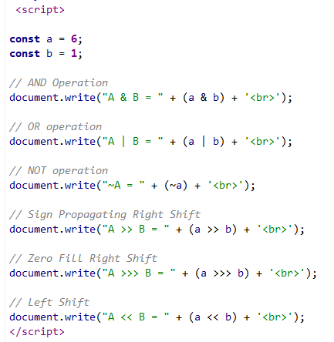
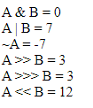
Worked examples (JavaScript Operators)
Example: JS operators

Slide 13
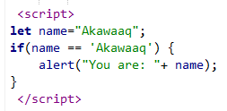
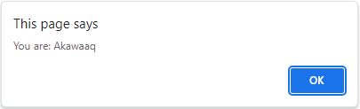
Control Structures: If-Else
Used to perform different actions based on different conditions.
Syntax: if (condition) { code } else { code }.
Else-if ladder allows for multiple conditions.
Example: Checking if a student passed a test based on a score variable.
Ternary operator: (condition) ? valueIfTrue : valueIfFalse.

Slide 14
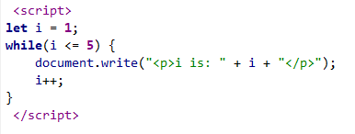

Control Structures: Loops
for loop: Repeats code a specific number of times.
while loop: Repeats code while a condition is true.
do...while: Executes code once, then repeats if the condition is true.
Used for iterating through arrays or generating dynamic HTML lists.
Example: Printing numbers 1 to 5.

Slide 15
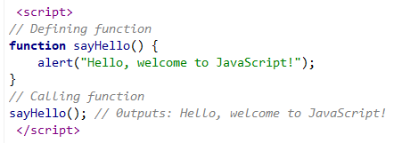
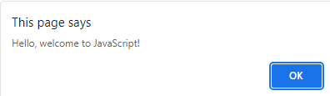
Functions in JavaScript
A function is a block of code designed to perform a particular task.
Defined with the function keyword.
Syntax: function name(parameters) { code to be executed }.
Functions are executed when they are called (invoked).
Example: function greet(name) { return "Hello " + name; }.

Slide 16
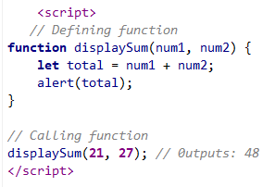
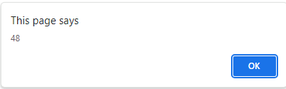
Function Parameters and Return Values
Parameters are the names listed in the function definition.
Arguments are the real values passed to the function when invoked.
The return statement stops execution and sends a value back to the caller.
Functions without a return statement return undefined.
Local variables declared inside a function are not accessible outside it.

Slide 17
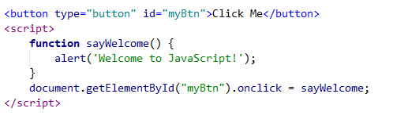
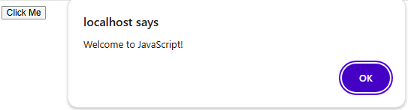
Assigning Functions to Events
Events are "things" that happen to HTML elements (clicks, mouseover, etc.).
JS can react to these events.
Method 1: HTML Attribute: <button onclick="myFunc()">Click</button>.
Method 2: DOM Property: element.onclick = myFunc;.
Method 3: Event Listener: element.addEventListener("click", myFunc);.

Slide 18
Common JavaScript Events
onclick: User clicks an element.
onmouseover: User moves the mouse over an element.
onmouseout: User moves the mouse away from an element.
onkeydown: User pushes a keyboard key.
onload: The browser has finished loading the page.

Slide 19
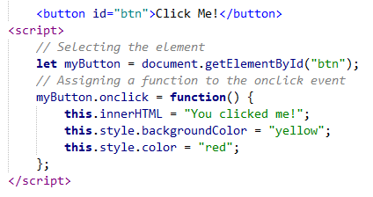

Worked Example 2: Event Handling
This changes button text and color dynamically on click.

Slide 20
JavaScript Objects
Objects are variables that can contain many values.
Written as name:value pairs inside curly braces {}.
Example: let car = {type:"Fiat", model:"500", color:"white"};.
Accessed via dot notation: car.model or bracket notation: car["model"].
Methods are functions stored as object properties.

Slide 21
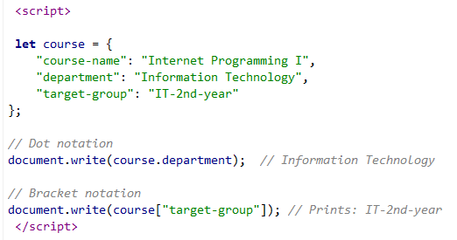

Worked example (JavaScript Objects)
Example:

Slide 22
JavaScript Arrays
Used to store multiple values in a single variable.
Example: let students = [“Bitsiat", “Amayu", “Heran"];.
Arrays are zero-indexed (the first element is 0).
Properties: fruits.length returns the number of items.
Methods: push() adds an item, pop() removes the last item.

Slide 23
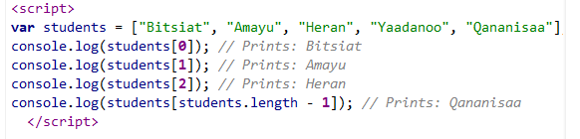

Worked example (JavaScript Arrays)
Example:

Slide 24
Sessions and Cookies Introduction
HTTP is stateless; cookies and sessions help remember user data.
Cookies: Small text files stored on the user's computer by the browser.
Sessions (Client-side): Temporary data storage for the duration of the page visit.
JavaScript can create, read, and delete cookies using document.cookie.
Modern alternative: localStorage and sessionStorage.

Slide 25
Handling Cookies in JavaScript
Creating: document.cookie = "username=Hawi; expires=Thu, 10 May 2026 12:00:00 UTC; path=/";.
Reading: let x = document.cookie; returns all cookies as a string.
Deleting: Set the expiration date to a past date.
Cookies are often used for login tokens or site preferences.
Security note: Be careful storing sensitive data in cookies.

Slide 26
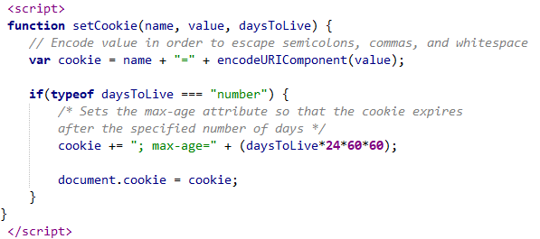
Worked example(creating cookies)
Example: creating cookies

Slide 27
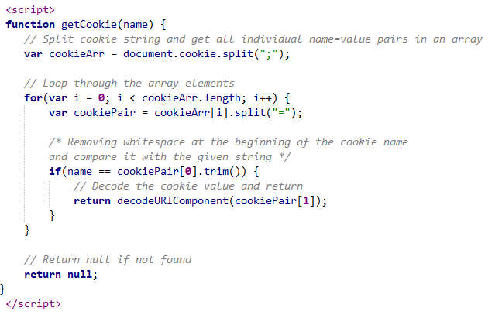
Worked example(reading cookies)
Example: reading cookies

Slide 28
LocalStorage vs. SessionStorage
localStorage: Data persists even after the browser is closed and reopened.
sessionStorage: Data is cleared when the page session ends (tab is closed).
Syntax: localStorage.setItem("key", "value");.
Retrieval: localStorage.getItem("key");.
Storage limit is much higher than cookies (approx. 5MB).

Slide 29
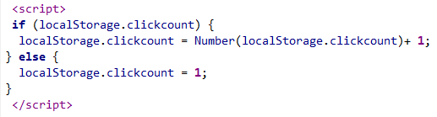
Worked example (LocalStorage)
Example: LocalStorage

Slide 30
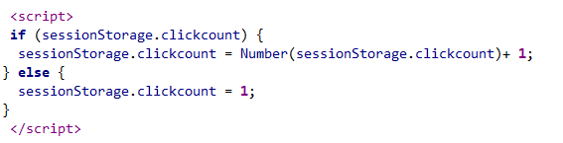
Worked example (SessionStorage)
Example: SessionStorage

Slide 31
Practical Exercise: Interactive Greeting
Task: Create a page that asks for a user's name using a prompt.
Store the name in localStorage.
Display a greeting "Welcome [Name]" on the page.
Add a button to "Clear Name" which removes it from storage and refreshes.

Slide 32
JavaScript Debugging
Use console.log() to check variable values during execution.
Browser Developer Tools (F12) or ctrl+shift+i is the primary environment for debugging.
The "Console" tab shows syntax and runtime errors.
The "Sources" tab allows setting breakpoints to pause code execution.
debugger; keyword can be placed in code to trigger a breakpoint.

Slide 33
JavaScript Best Practices
Avoid global variables to prevent naming conflicts.
Always declare variables with let or const.
Place scripts at the bottom of the HTML <body> to speed up page loading.
Use meaningful variable names (camelCase).
Comment complex logic for future maintenance.

Slide 34
Chapter Summary
JavaScript adds interactivity to the web.
We covered syntax, variables, and data types.
Functions and events are the core of interactive programming.
Storing data locally can be done via cookies or web storage.
Next: Applying JS to HTML Forms.

Slide 35
Ended!
Internet Programming I (ITec2092)
Chapter Four:
JavaScript
2026

